Slide 1
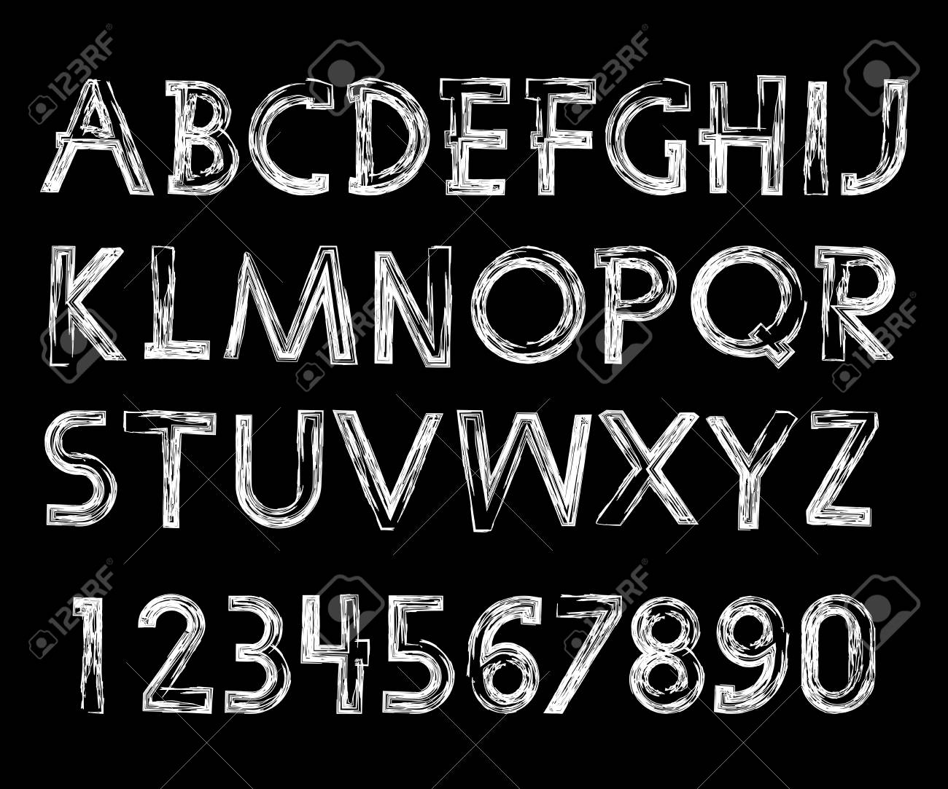

Slide 2
Text Detection
Image Processing Course Project
Charan Kamarapu(2018111)
Lanka Sai Krishna(2018132)
Mudavath Sai Kiran(2018152)

Slide 3

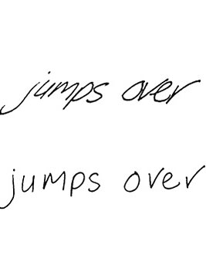
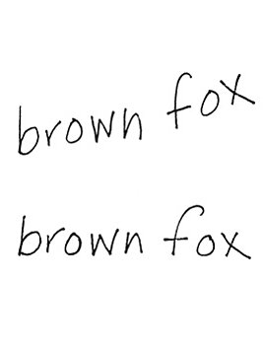
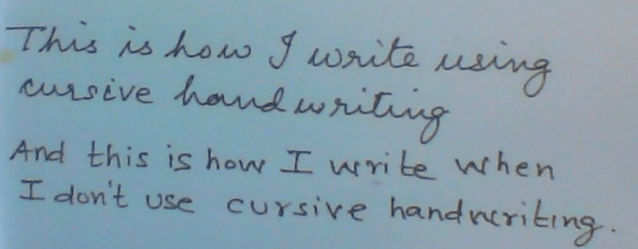
Handwriting Categories

Slide 4
PROCESS
Input/Source: The source or input of this project will be an unclear/improperly scanned/ blurred handwritten text or scanned books which may have different kinds of noise.
Image Enhancement and detection:
Pre-processing
Segmentation
Feature Extraction
Post-processing

Slide 5
Output/Result: The output will be an editable text document or pdf.

Slide 6
STAGES
Pre-processing:
1) Acquisition of image ,resizing , Grayscale transformation.
2) Binarization
3) Noise Removal
4) Skew Correction
5) Skeletonization
Segmentation:
6) Line level Segmentation
7) Word level Segmentation
8) De-slanting
9) Character level Segmentation

Slide 7
Feature Extraction:
10)model Training and prediction.
Postprocessing:
11)spell correction and document conversion.

Slide 8
Pre-processing
The raw data is subjected to a number of preliminary
processing steps to make it usable in the descriptive stages of character analysis. Pre-processing aims to produce data
that are easy for the model to operate accurately. The
main objectives of pre-processing are :
Acquisition of image , Grayscale transformation.
Binarization
Noise Removal
Skeletonization
Skew Correction

Slide 9
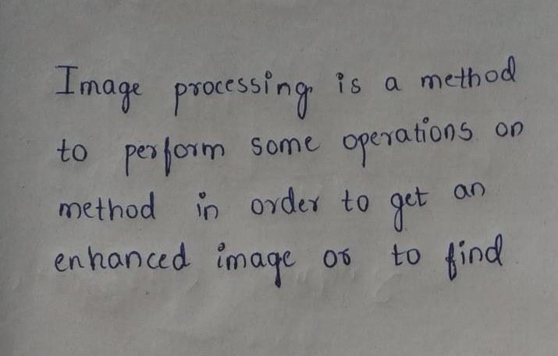
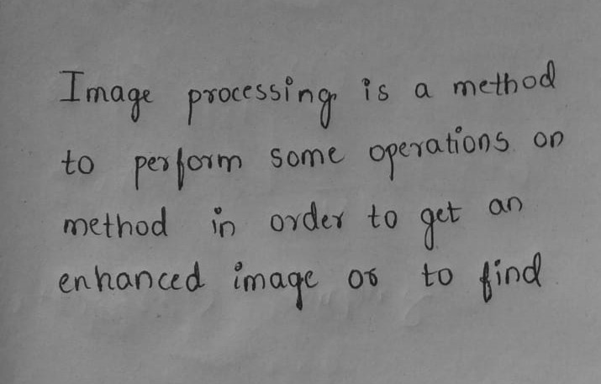
Acquisition of image and Grayscale transformation.

Slide 10
Binarization
Binarization : This generally means changing the pixel value to its lowest possible value or highest possible value by selecting a threshold value from the image . the pixel which greater value than threshold will be shifted to highest and if less than to the lowest.
Otsu’s Binarization :This method gives a threshold for the whole image considering the various characteristics of the whole image(like lighting conditions, contrast, sharpness ) , yet we may loose few info at the darker regions .

Slide 11
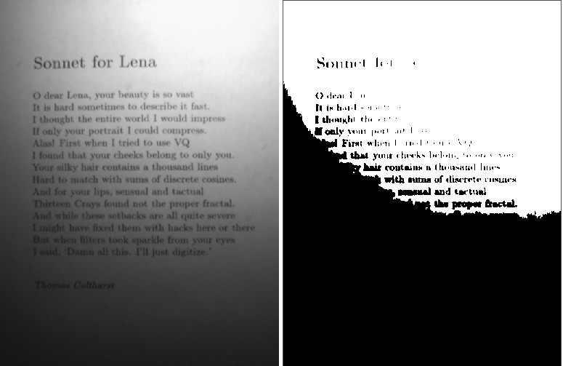

Slide 12
Adaptive Thresholding : This method gives a threshold for a small part of the image depending on the characteristics of its locality and neighbor pixel there is no single fixed threshold for the whole image but every small part of the image has a different threshold depending upon the locality and also gives smooth transition.
Here threshold is the weighted sum of neighborhood values where weights are a Gaussian window . This eliminates our problem of lighting uniformity
Adaptive thresholding is the best way of binarizing in the context of the project.

Slide 13
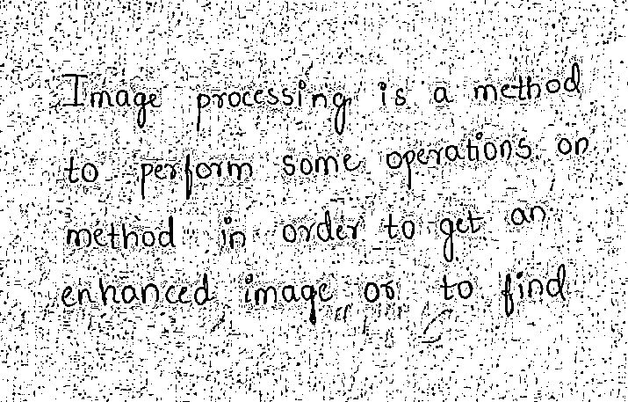

Slide 14
Noise Reduction
Noise reduction improves the quality of the document. The main objective of the Noise removal stage is to smoothen the image by removing small dots which have high intensity than the rest of the image.
One way of performing Noise removal by using OpenCV medianBlur function.

Slide 15
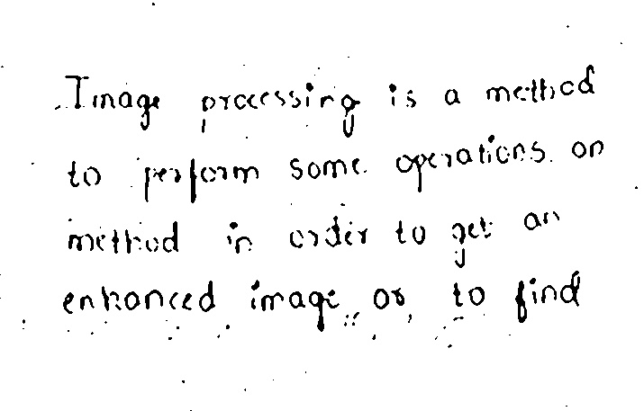

Slide 16
Skeletonization
Skeletonization: for handwritten text, different writers have a different style of writing and hence different stroke width . So to make the width of strokes uniform, we have to perform this process . This help in detecting cursive writings
Dilation : A pixel in the original image (either 1 or 0) will be considered 1 if any one of the pixels under the
kernel is 1, otherwise it is eroded (made to zero).
Thus all the pixels near boundary will be discarded depending upon the size of kernel, even the iterations are also important

Slide 17
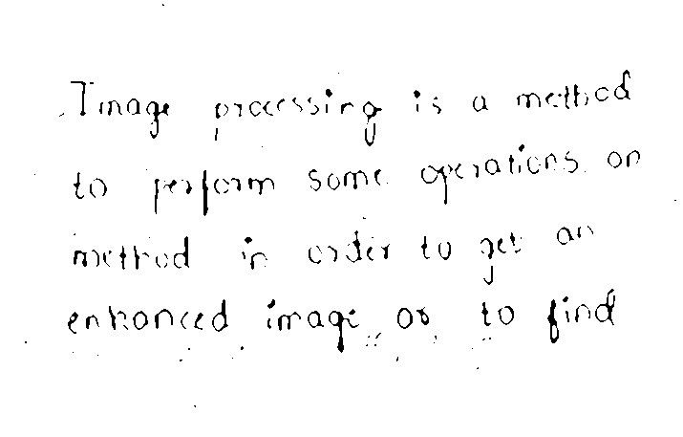

Slide 18
Skew Correction
While scanning a document, it might be slightly skewed (image aligned at a certain angle with horizontal)
sometimes .
Projection profile method:
i) Taking the sum of black pixels in row wise to get a histogram of pixels along the height of the image.
ii) Now the image is rotated at various angles and the variance will be calculated The angle at which the maximum Variance is found, that corresponding angle will be the Skew angle for the image.
iii) After finding the Skew angle, we can correct the skewness by rotating the image through an angle equal to the skew angle in the opposite direction of skew.

Slide 19
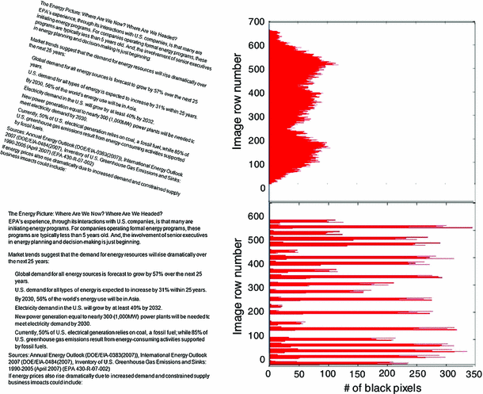
Histogram of
Skewed image
Histogram of
de-skewed
image

Slide 20
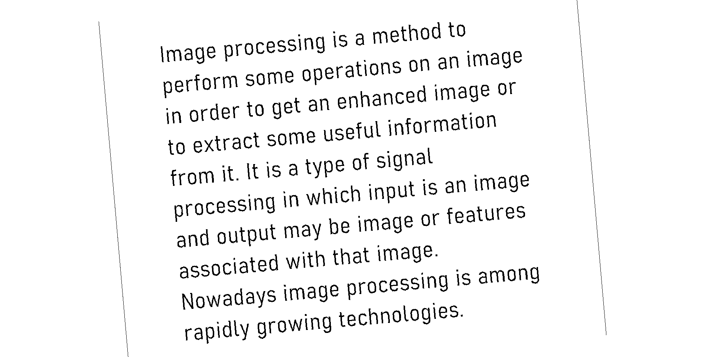
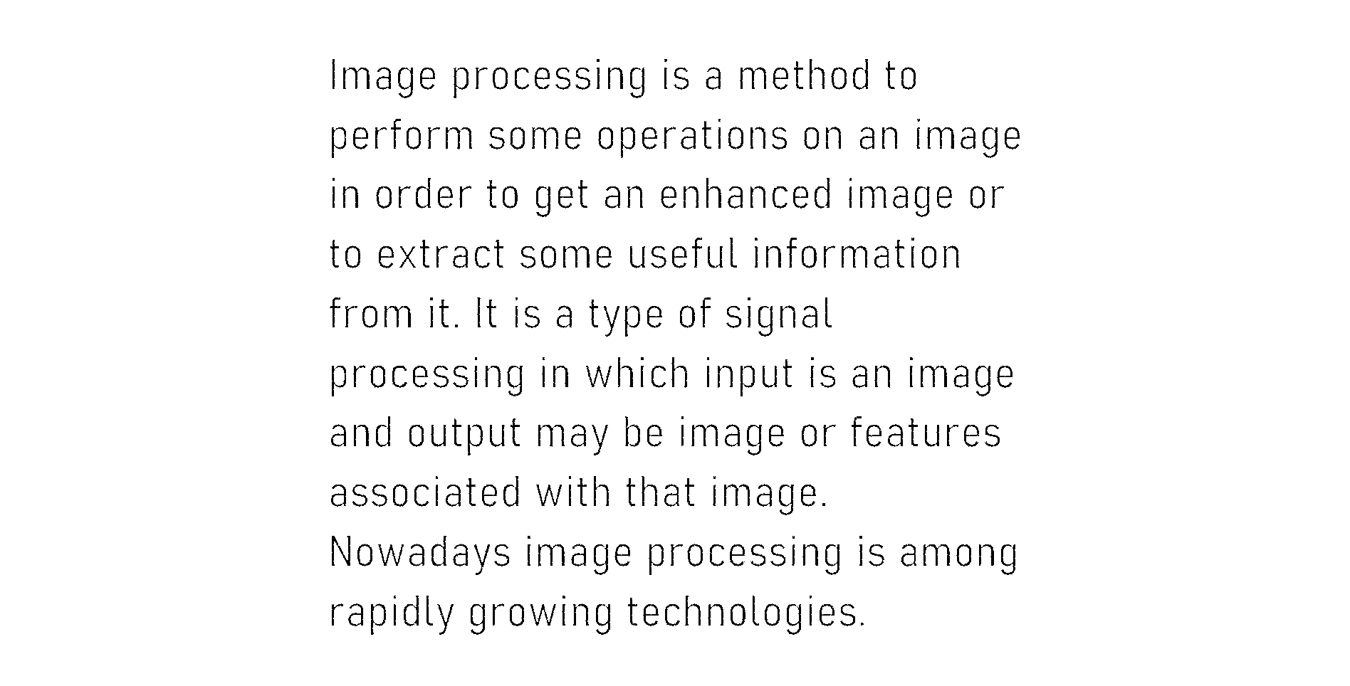

Slide 21
Segmentation
Line level Segmentation
Word level Segmentation
De-slanting
Character level Segmentation

Slide 22
Line level Segmentation
If we observe the histogram we plotted for the skew correction the high peaks tell us that the no of foreground pixels are high at that particular row number i.e nothing but our sentence, we use this technique to segment the lines.

Slide 23


Slide 24
Word level Segmentation
In this segmentation we considered the line which are segmented earlier .
For every line we again calculate the histogram but this time for columns and find the gaps as same as we did for
Line segmentation.
We need to fix a threshold for the gap if not even the gaps between the characters will also be detected and cause problem.

Slide 25
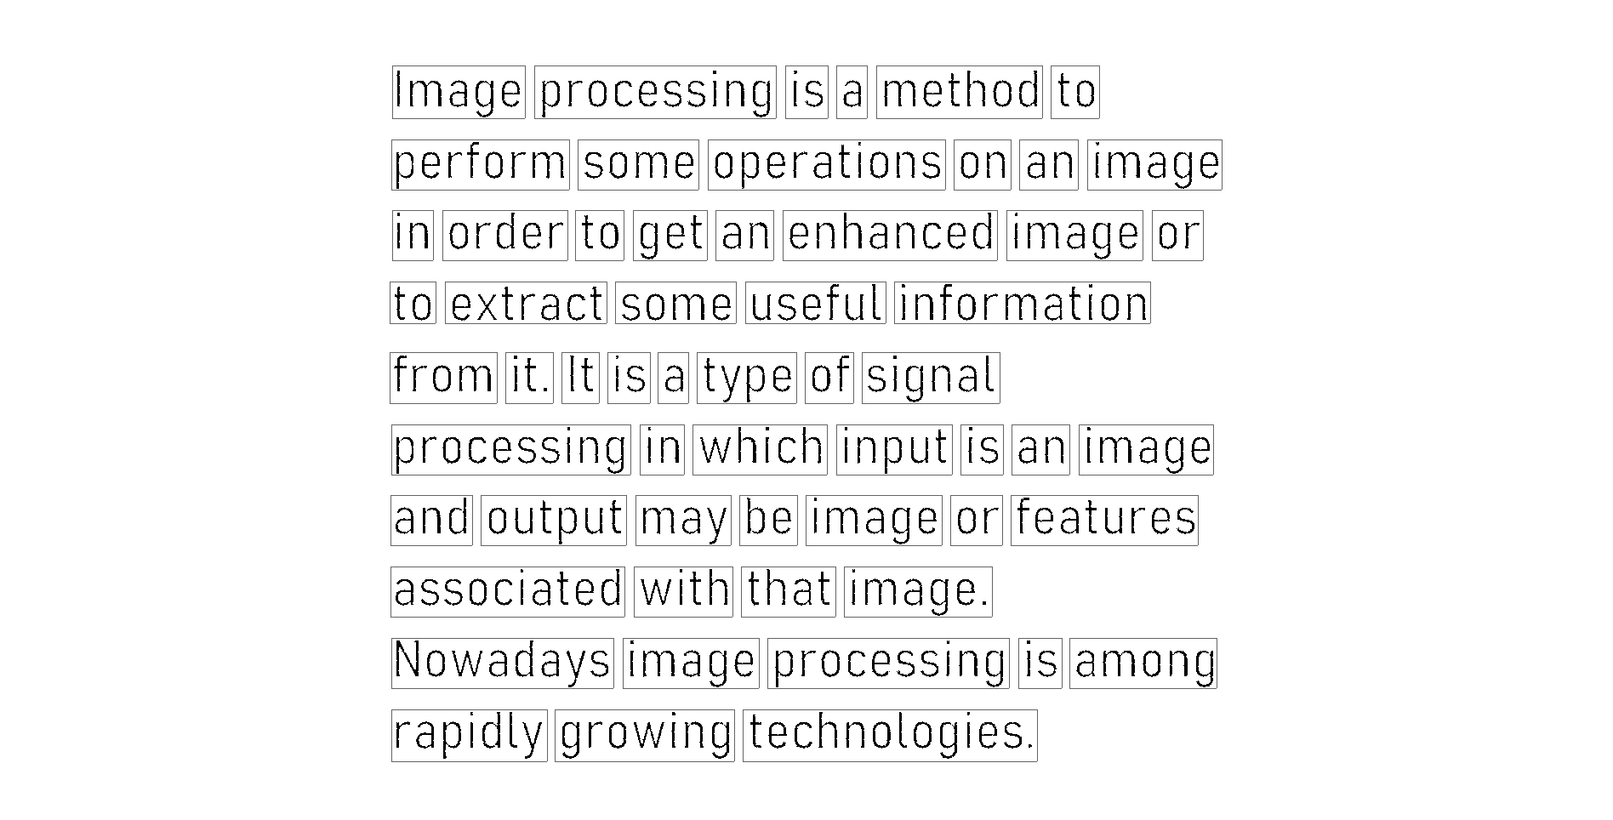

Slide 26
Slant Removal
The slant of handwritten texts varies from user to user. Slant removal methods are used to normalize the all characters to a standard form.
Here we apply this for every word which we have segmented earlier
Now repeat the process we did for skew correction but use column histogram and shearing instead of rotation

Slide 27
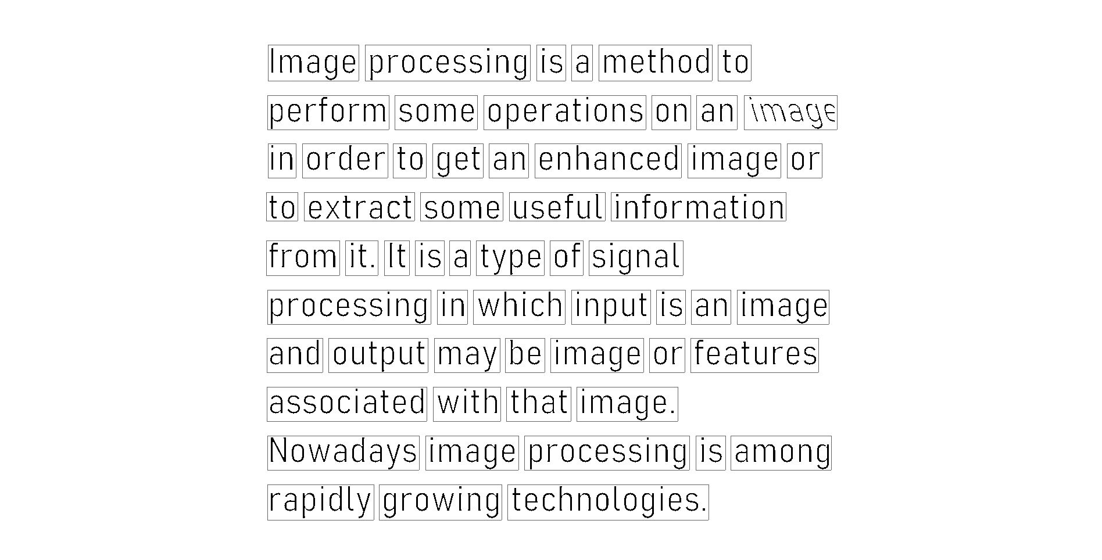
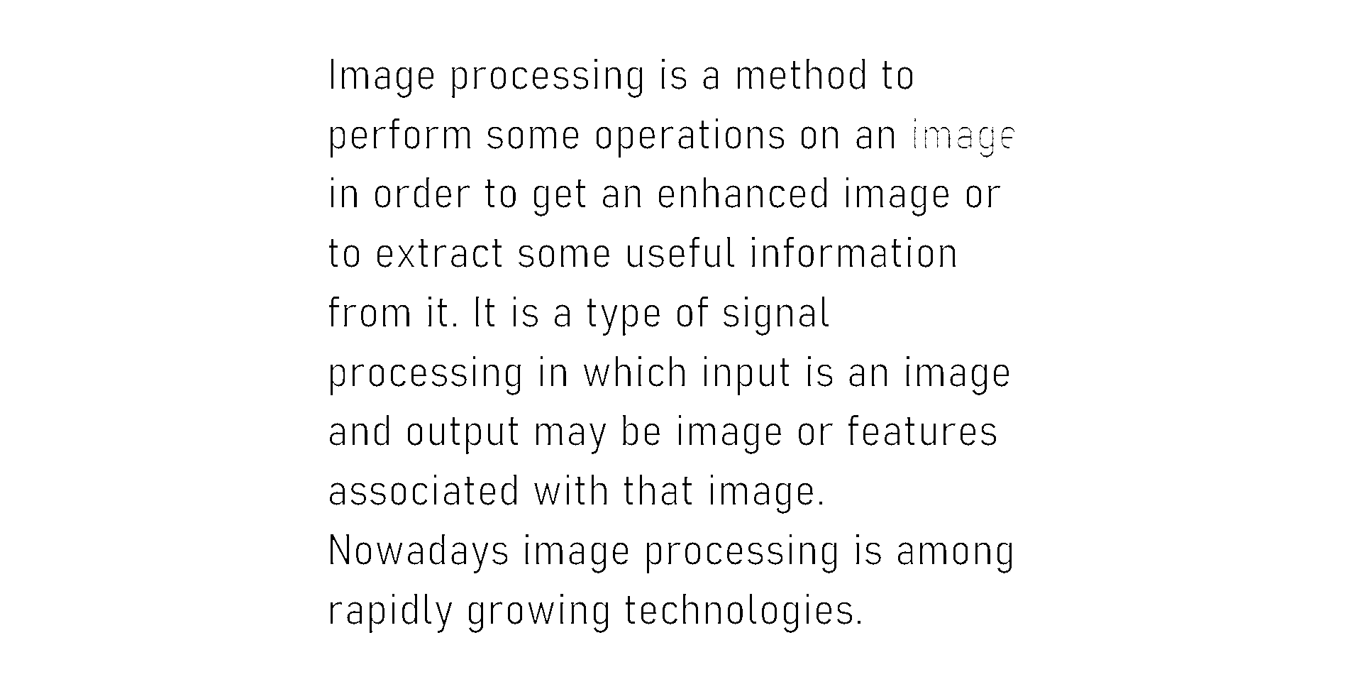

Slide 28
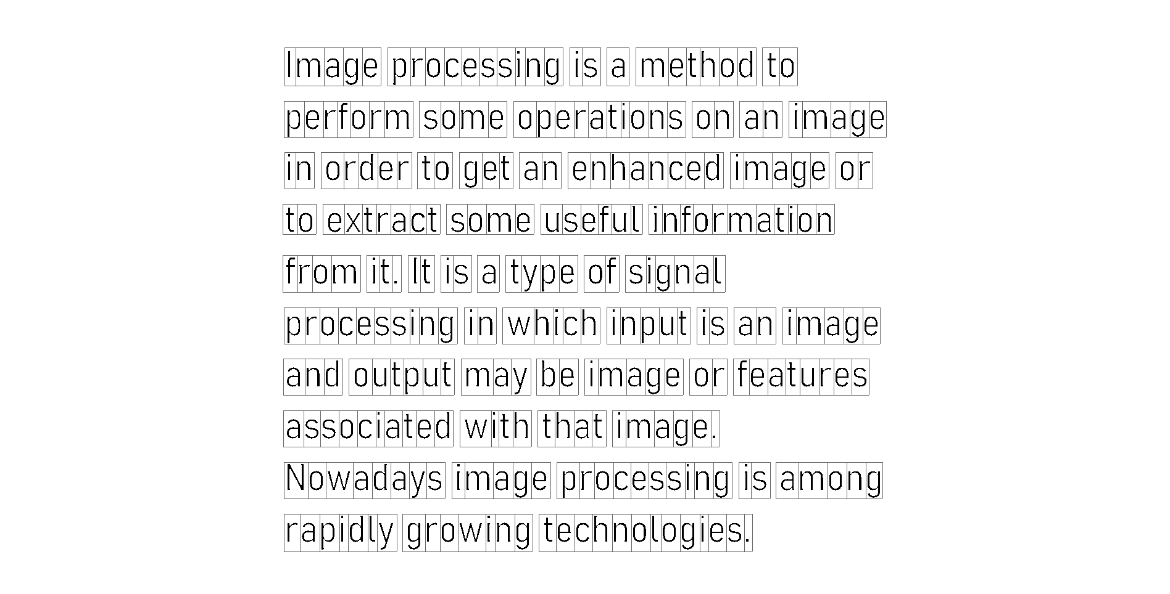
Character level Segmentation
Now repeat the process we did for word segmentation on every word but we have no threshold value here

Slide 29
Feature Extraction
In feature extraction stage each character is represented as a feature vector, which becomes its identity. The major goal of feature extraction is to extract a set of features, which maximizes the recognition rate with the least amount of elements.
Due to the nature of handwriting with its high degree of variability and imprecision obtaining these features, is a difficult task. Feature extraction methods are based on 3 types of features:
Statistical
Structural
Global transformations and moments

Slide 30
Statistical Features
Representation of a character image by statistical distribution of points takes care of style variations to some extent.
The major statistical features used for character representation are:
Zoning
Projections and profiles
Crossings and distances

Slide 31


Zoning
□ The character image is divided into NxM zones. From each zone features are extracted to form the feature vector. The goal of zoning is to obtain the local characteristics instead of global characteristics

Slide 32

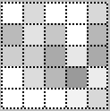
Zoning – Density Features
□ The number of foreground pixels, or the normalized number of foreground pixels, in each cell is considered a feature.
Darker squares indicate higher density of zone pixels.

Slide 33


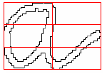
Zoning – Direction Features
□ Based on the contour of the character image
□ For each zone the contour is followed and a directional histogram is obtained by analyzing the adjacent pixels in a 3x3 neighborhood

Slide 34


Zoning – Direction Features
Based on the skeleton of the character image
Distinguish individual line segments
Labeling line segment information
Line segments are coded with a direction number
2 = vertical line segment
3 = right diagonal line segment 4 = horizontal line segment
5 = left diagonal line segment

Slide 35
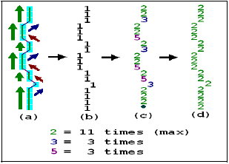
Zoning – Direction Features
Based on the skeleton of the character image
Distinguish individual line segments
Labeling line segment information
Line type normalization

Slide 36



Zoning – Direction Features
Based on the skeleton of the character image
Distinguish individual line segments
Labeling line segment information
Line type normalization
Formation of feature vector through zoning
number of horizontal lines | total length of horizontal lines | number of right diagonal lines | total length of right diagonal lines | number of vertical lines | total length of vertical lines | number of left diagonal lines | total length of left diagonal lines | number of intersection points

Slide 37
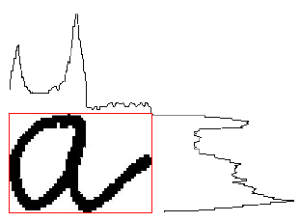
Projection Histograms
The basic idea behind using projections is that character images, which are 2-D signals, can be represented as 1-D signal. These features, although independent to noise and deformation, depend on rotation.
Projection histograms count the number of pixels in each column and row of a character image. Projection histograms can separate characters such as “m” and “n” .

Slide 38

Profiles
□ The profile counts the number of pixels (distance) between the bounding box of the character image and the edge of the character. The profiles describe well the external shapes of characters and allow to distinguish between a great number of letters, such as “p” and “q”.

Slide 39
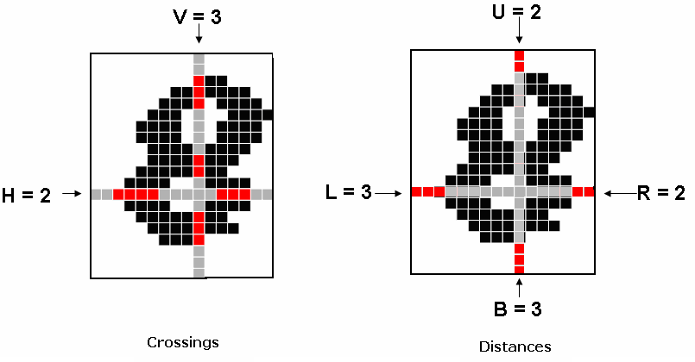
Crossings and Distances
□ Crossings count the number of transitions from background to foreground pixels along vertical and horizontal lines through the character image and Distances calculate the distances of the first image pixel detected from the upper and lower boundaries, of the image, along vertical lines and from the left and right boundaries along horizontal lines

Slide 40
Structural Features
Characters can be represented by structural features with high tolerance to distortions and style variations. This type of representation may also encode some knowledge about the structure of the object or may provide some knowledge as to what sort of components make up that object.
Structural features are based on topological and geometrical properties of the character, such as aspect ratio, cross points, loops, branch points, strokes and their directions, inflection between two points, horizontal curves at top or bottom, etc.

Slide 41
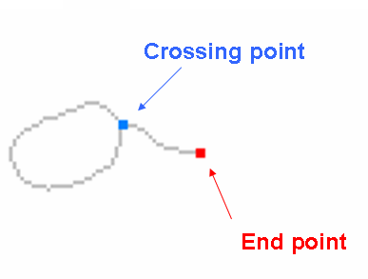
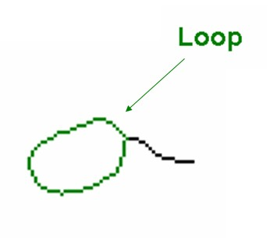
Structural Features

Slide 42
Classification
Here we tried using SVM classifier , In this classifier the earlier mentioned all features done .Here every pixel is treated as a feature and through training this classifier creates a vector for a particular letter which consists of features related to particular letter.
But the time complexity of the training this classifier is too high.
So, I have opted for Neural networks which does the same work for me.
I used a model and trained it with emnist byclass images and then predicted the images which I have segmented by resizing them to a particular size which is required for the model to predict.

Slide 43
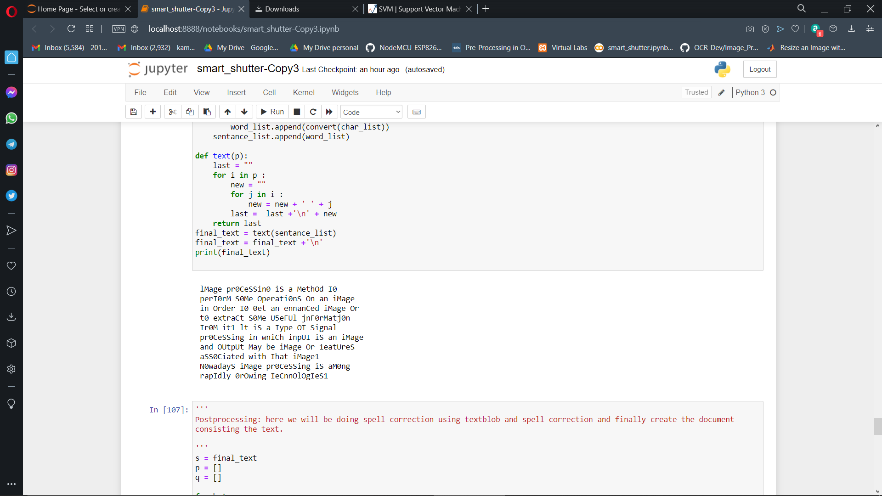

Slide 44
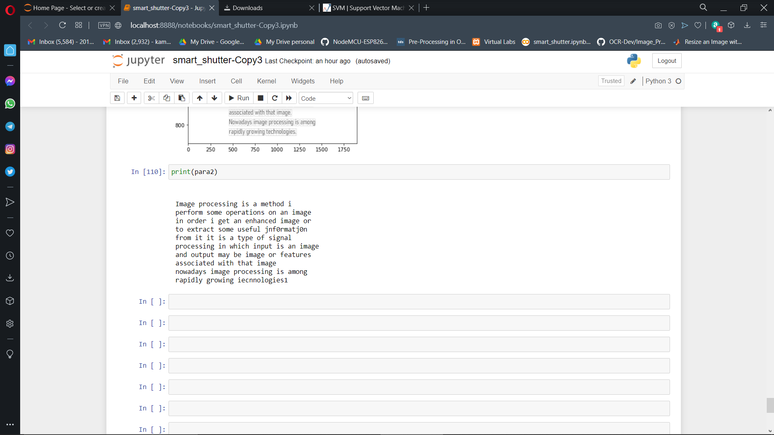
Post-processing
Now we apply spell correction to final text which we got

Slide 45
THANK YOU

